Slide 1
Design and Implementation of a Secure Network Infrastructure Group 10
System Administration
Supervisor: Dr djouala
"Security is not a product, but a process - an ongoing, evolving process. It's about embedding a culture of resilience, vigilance, and adaptability into the very fabric of our digital existence."
Faculty Of Engineering And Technology

Slide 2
Outline
Introduction
Overview of Network Security Principles(Importance, principles, threads and mitigation)
Designing a Secure Network Architecture
Implementation of Firewalls and IDPS
Demonstrating Secure Communication Protocols
Building a Small Secure Campus Area (Huawei ENSP)
References
Q&A

Slide 3
Introduction
This project shows how to design and implement a secure network infrastructure that can protect data and prevent cyberattacks.
It covers four topics: network security principles, secure network architecture, security measures, and secure communication protocols.
It also applies these principles to a practical scenario by creating a secure Campus Area Network (CAN) within a campus environment. The project demonstrates the skills and knowledge of system administration and network security, as well as the creativity and innovation of the project team. The presentation will provide a clear and comprehensive guide for creating a robust and secure network.

Slide 4
Overview of Network Security Principles
Importance of Network Security
Basic Principles of Network Security
Confidentiality:
Integrity
Availability
Common Threats and How to Mitigate Them.

Slide 5
Common Threats and How to Mitigate Them.
Malware:
Phishing
Man-in-the-Middle (MitM) Attacks
Denial-of-Service (DoS) and Distributed Denial-of-Service (DDoS) Attacks:
SQL Injection:

Slide 6
Implementation of Firewalls and IDPS
What is Network Design? planning, design, and implementation -> data transfer requirements of a company
Factors to Consider When Designing a Secure Network.
Embedded (Built-in) Security Measures
Standardization of Software and Hardware
Network Resiliency
Redundancy

Slide 7
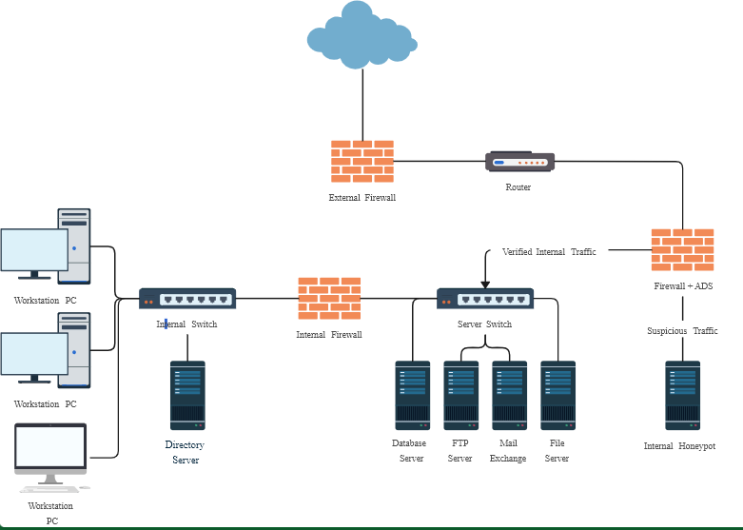

Slide 8
Best Practices in Designing a Secure Network Architecture
Inventory And Diagram All Network Assets:
Seek Input From Decision Makers.
Implement Least Privilege
Adopt A Zero-Trust Model
Follow ‘Defence In Depth’ Principles
Automatically Encrypt Data
Create VLANs

Slide 9
Implementation of Firewalls and Intrusion Detection/Prevention Systems.
What is a firewall??
Role of Firewalls in Network Security
Different Types of Firewalls and Their Implementation
Packet-filtering firewalls:
Stateful inspection firewalls:
Proxy firewalls:
Unified threat management (UTM) firewalls
Next-generation firewalls (NGFWs):

Slide 10
Implementing A firewall in Linux.
Demonstration by Raymond

Slide 11
Intrusion Detection and Prevention System: How They Work and their Implementation.
Two type can be identified
Network-based IDPS (NIPS):
Host-based IDPS (HIPS):

Slide 12
techniques to identify threats
Signature-based threat detection
Anomaly-based detection#
Stateful protocol analysis

Slide 13
Demonstrating Secure Communication Protocols
Importance of Secure Communication Protocols
Common Secure Communication Protocols and Their Uses
Secure Sockets Layer (SSL) and Transport Layer Security (TLS):
Secure Shell (SSH):

Slide 14
SSH Demonstration
By Emanuel

Slide 15
Building a Small campus area with Huawei ENSP software to demonstrate a system admin roles.
Since the aim of this project is to test the capability of one to built a network, we will not go too deep into network building.
We will rather concentrate on demonstrating it security and admin role.

Slide 16
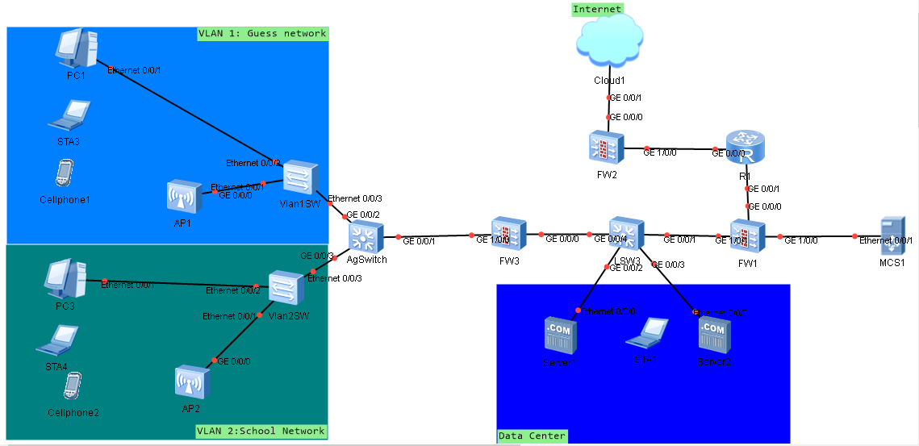
Topology

Slide 17
Reference
17 Key Strategies For Designing A Secure, Efficient Network (forbes.com)
4 Critical Network Design Considerations You Don't Want to Overlook - Maryland IT Solutions
Huawei Datacom

Slide 18
Thank you for your kind Attention Q & A

